Slide 1
Welcome to Week-11
Advanced Programming in Python
By Engr. Imran Khan
Instructor
24th August 2021

Slide 2
Today
Introduction to Supervised Machine Learning
Overfitting and Underfitting
Supervised Learning: Datasets
K-Nearest Neighbors: Classification, Regression and Clustring
Multi-Class Classification
Cross-Validation

Slide 3
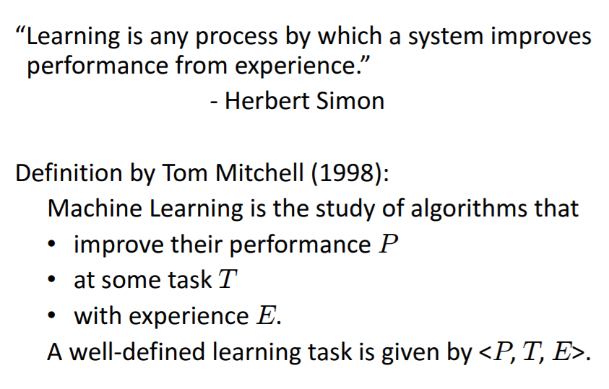
Supervised Machine Learning
Notes:
We can also get out of a while whenever we want with break.
Usually used with an if statement
Redo last example
Can also be used in for loops

Slide 4
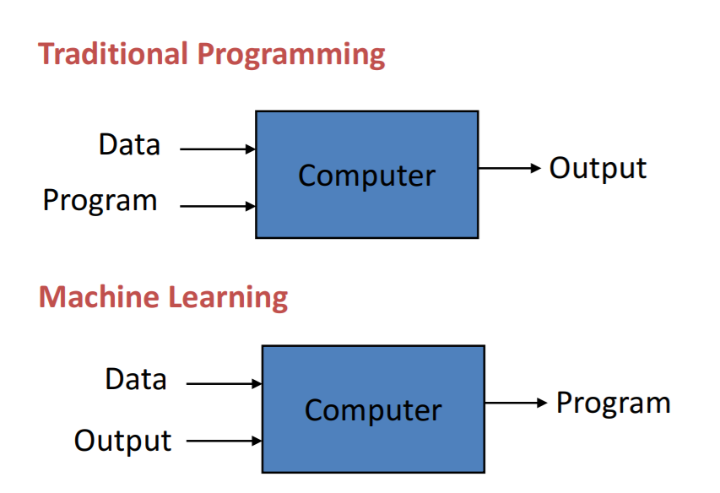
Supervised Machine Learning
Notes:
We can also get out of a while whenever we want with break.
Usually used with an if statement
Redo last example
Can also be used in for loops

Slide 5
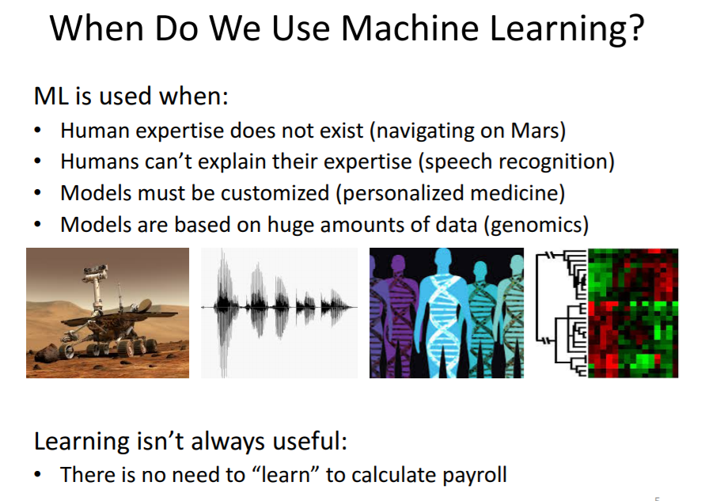
Notes:
We can also get out of a while whenever we want with break.
Usually used with an if statement
Redo last example
Can also be used in for loops

Slide 6
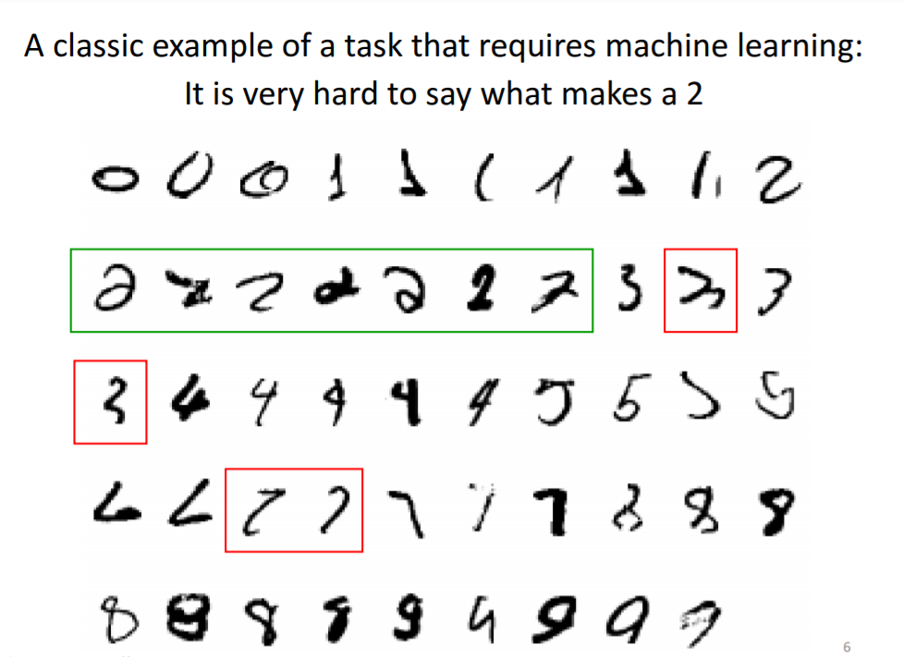
Notes:
We can also get out of a while whenever we want with break.
Usually used with an if statement
Redo last example
Can also be used in for loops

Slide 7
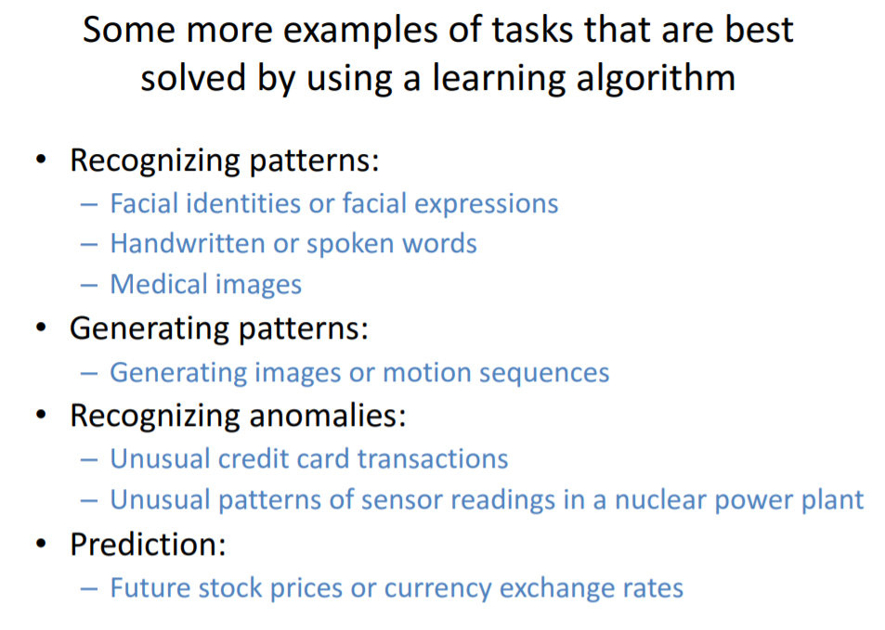
Notes:
We can also get out of a while whenever we want with break.
Usually used with an if statement
Redo last example
Can also be used in for loops

Slide 8

Notes:
We can also get out of a while whenever we want with break.
Usually used with an if statement
Redo last example
Can also be used in for loops

Slide 9
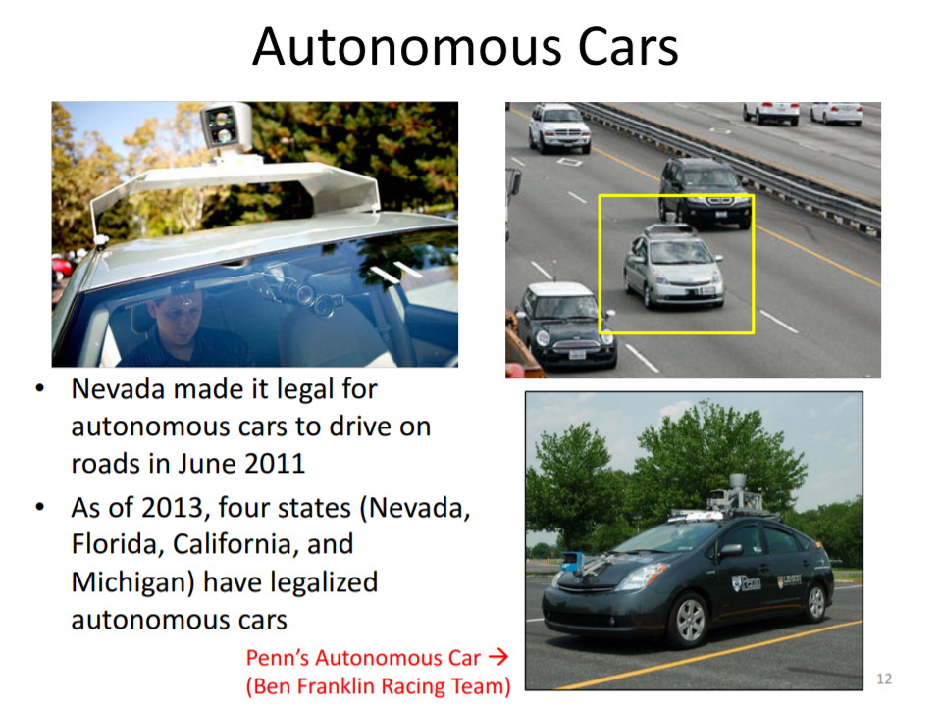
Notes:
We can also get out of a while whenever we want with break.
Usually used with an if statement
Redo last example
Can also be used in for loops

Slide 10
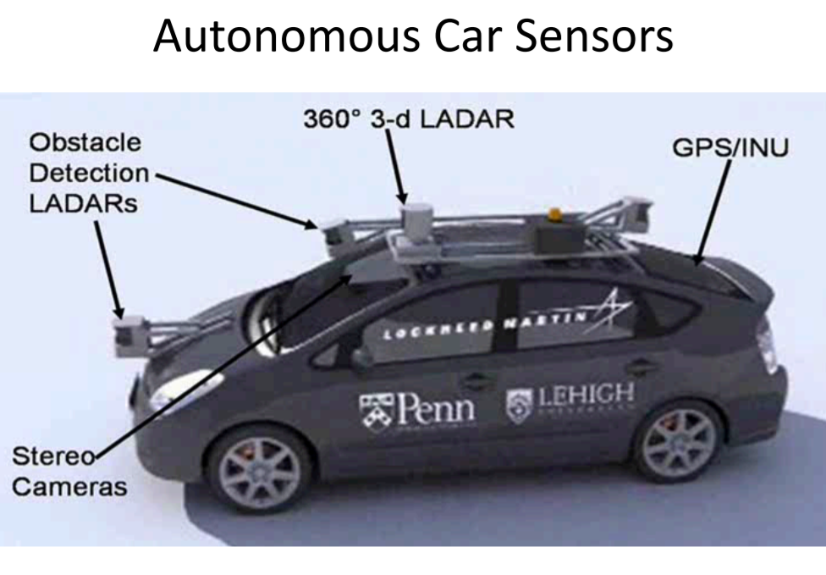
Notes:
We can also get out of a while whenever we want with break.
Usually used with an if statement
Redo last example
Can also be used in for loops

Slide 11
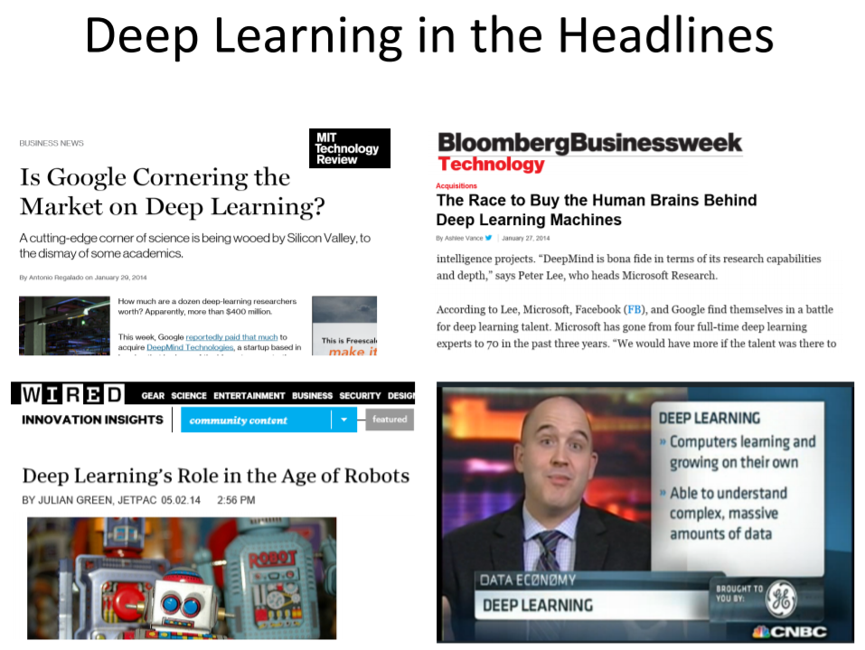
Notes:
We can also get out of a while whenever we want with break.
Usually used with an if statement
Redo last example
Can also be used in for loops

Slide 12
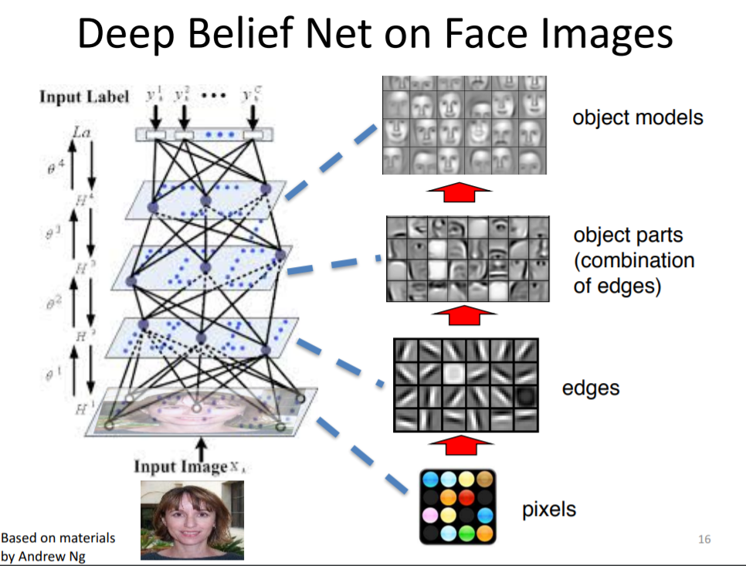
Notes:
We can also get out of a while whenever we want with break.
Usually used with an if statement
Redo last example
Can also be used in for loops

Slide 13
Notes:
We can also get out of a while whenever we want with break.
Usually used with an if statement
Redo last example
Can also be used in for loops

Slide 14
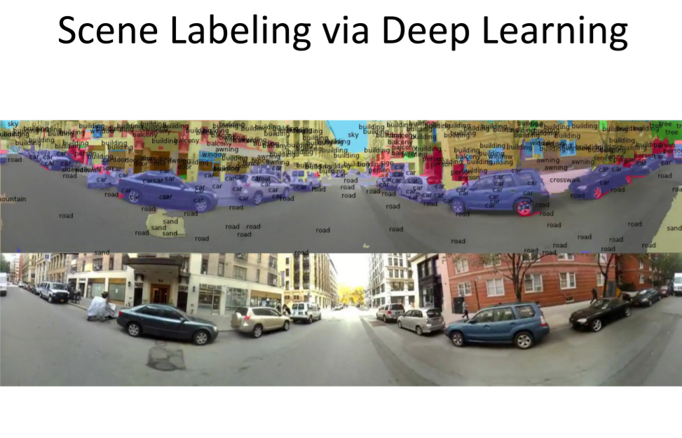
Notes:
We can also get out of a while whenever we want with break.
Usually used with an if statement
Redo last example
Can also be used in for loops

Slide 15
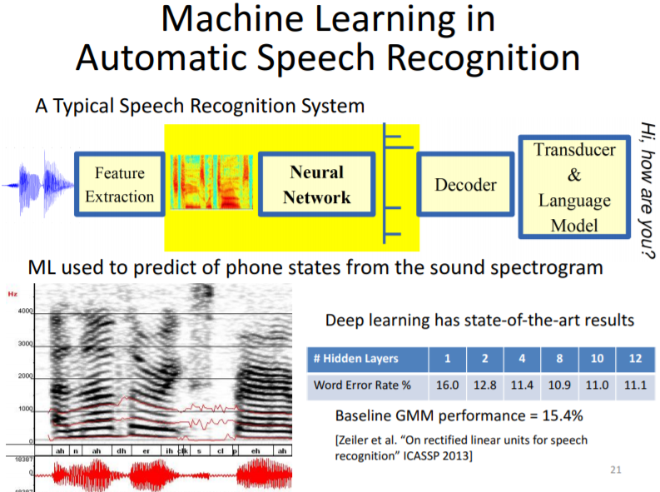
Notes:
We can also get out of a while whenever we want with break.
Usually used with an if statement
Redo last example
Can also be used in for loops

Slide 16
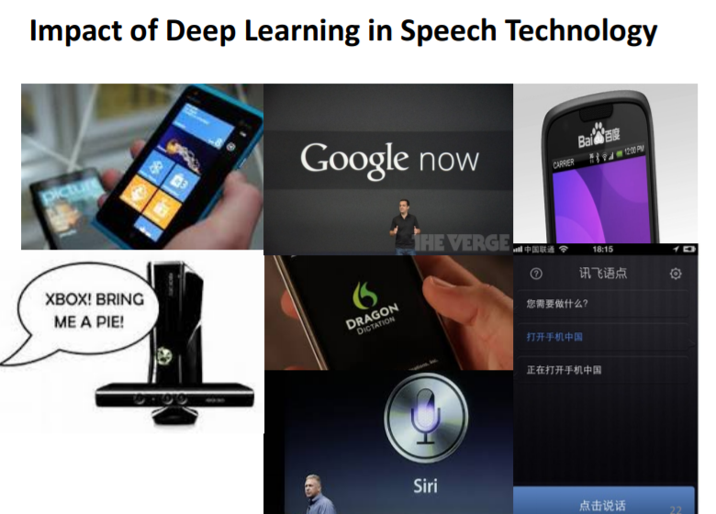
Notes:
We can also get out of a while whenever we want with break.
Usually used with an if statement
Redo last example
Can also be used in for loops

Slide 17
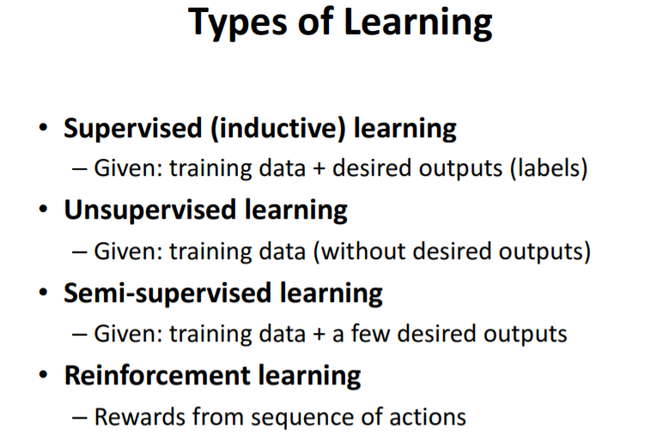
Notes:
We can also get out of a while whenever we want with break.
Usually used with an if statement
Redo last example
Can also be used in for loops

Slide 18
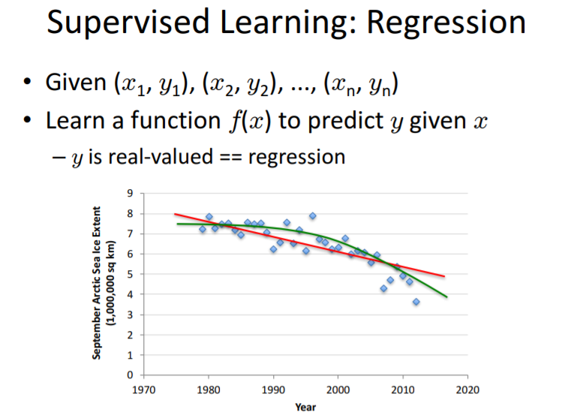
Notes:
We can also get out of a while whenever we want with break.
Usually used with an if statement
Redo last example
Can also be used in for loops

Slide 19
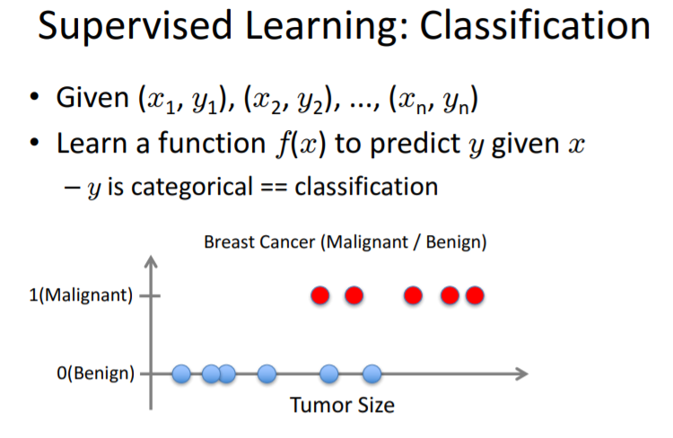
Notes:
We can also get out of a while whenever we want with break.
Usually used with an if statement
Redo last example
Can also be used in for loops

Slide 20
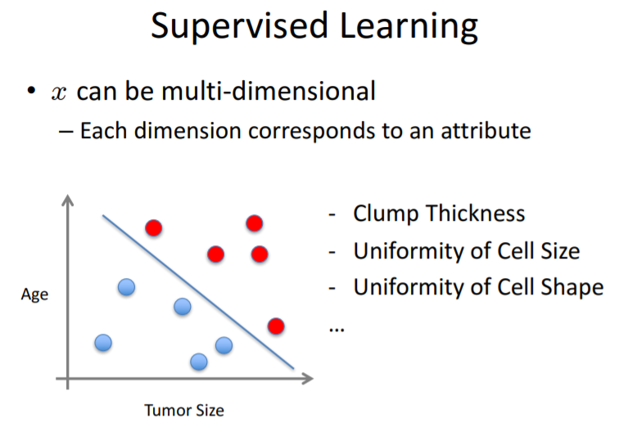
Notes:
We can also get out of a while whenever we want with break.
Usually used with an if statement
Redo last example
Can also be used in for loops

Slide 21
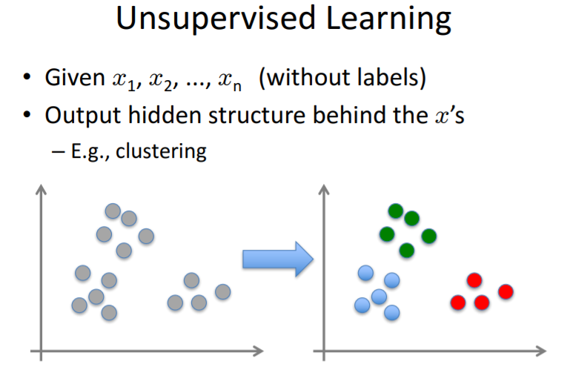
Notes:
We can also get out of a while whenever we want with break.
Usually used with an if statement
Redo last example
Can also be used in for loops

Slide 22
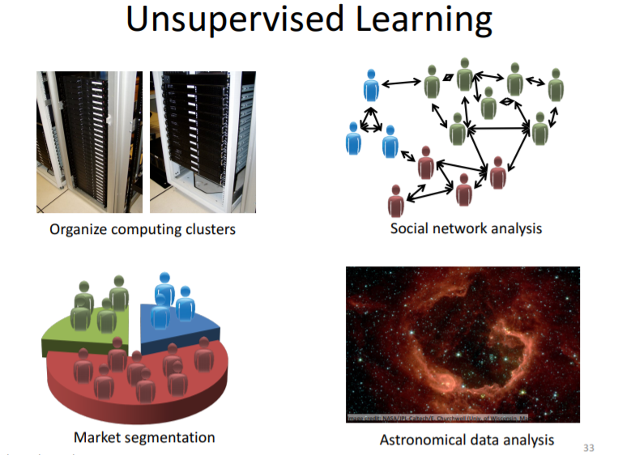
Notes:
We can also get out of a while whenever we want with break.
Usually used with an if statement
Redo last example
Can also be used in for loops

Slide 23
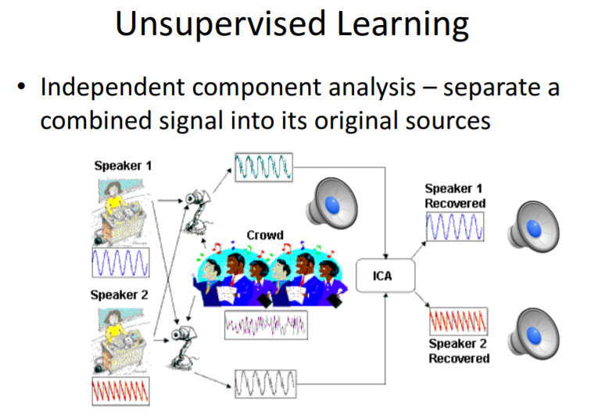
Notes:
We can also get out of a while whenever we want with break.
Usually used with an if statement
Redo last example
Can also be used in for loops

Slide 24
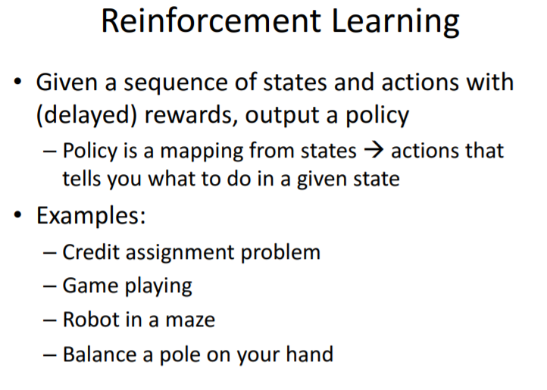
Notes:
We can also get out of a while whenever we want with break.
Usually used with an if statement
Redo last example
Can also be used in for loops

Slide 25
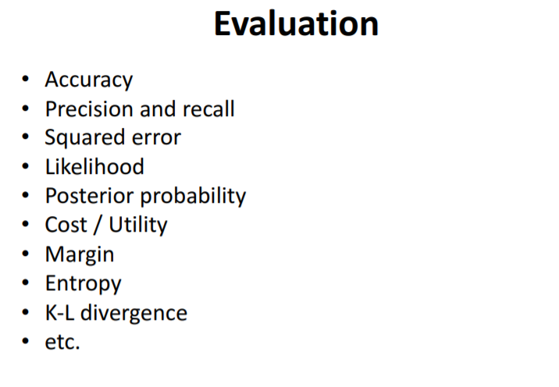
Notes:
We can also get out of a while whenever we want with break.
Usually used with an if statement
Redo last example
Can also be used in for loops

Slide 26
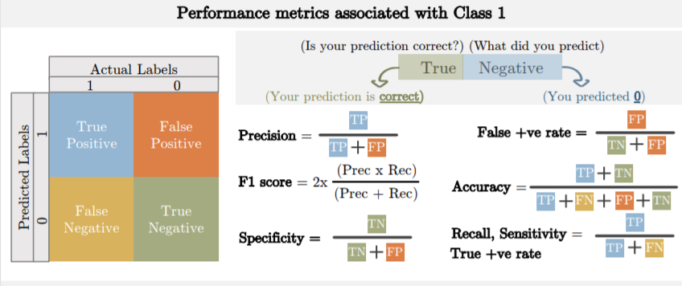
Notes:
We can also get out of a while whenever we want with break.
Usually used with an if statement
Redo last example
Can also be used in for loops

Slide 27
Overfitting and Underfitting

Slide 28
Bias and Variance
Bias – error caused because the model can not represent the concept
Variance – error caused because the learning algorithm overreacts to small changes (noise) in the training data
TotalLoss = Bias + Variance (+ noise)

Slide 29
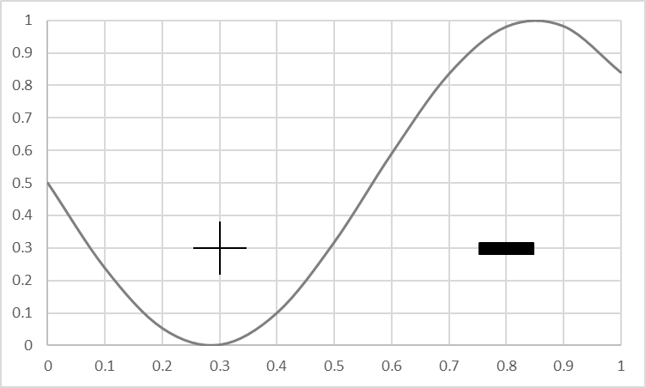
Visualizing Bias
Goal: produce a model that matches this concept
True Concept

Slide 30
Visualizing Bias
Goal: produce a model that matches this concept
True Concept

Slide 31
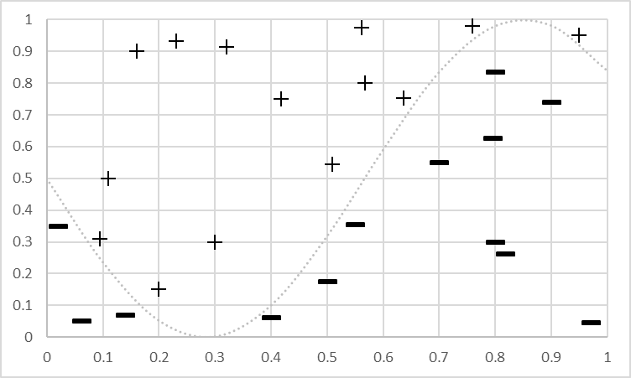
Visualizing Bias
Goal: produce a model that matches this concept
Training Data for the concept
Training Data

Slide 32
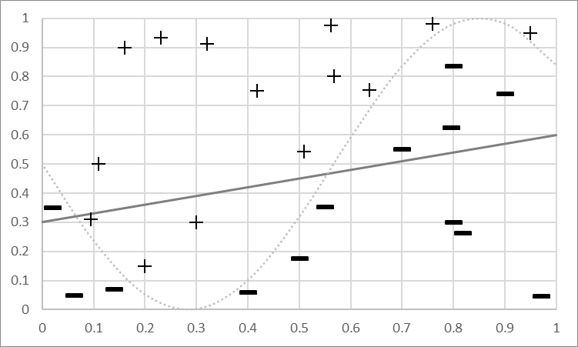
Visualizing Bias
Bias Mistakes
Goal: produce a model that matches this concept
Training Data for concept
Bias: Can’t represent it…
Model Predicts +
Model Predicts -
Fit a Linear Model

Slide 33
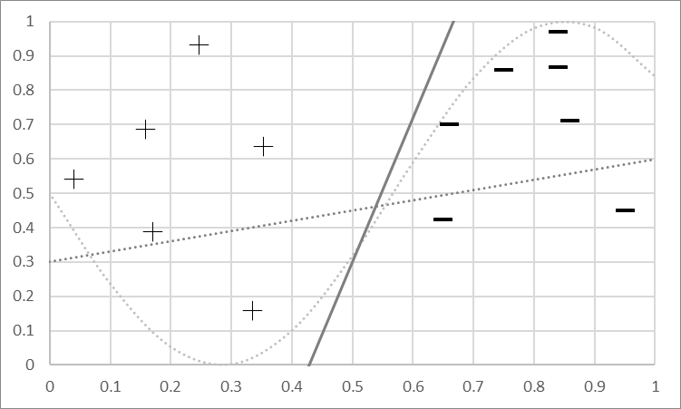
Visualizing Variance
Different Bias Mistakes
Goal: produce a model that matches this concept
New data, new model
Model Predicts +
Model Predicts -
Fit a Linear Model

Slide 34
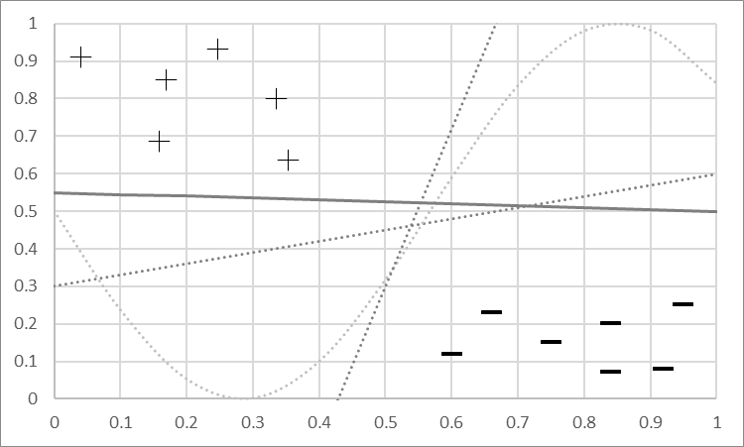
Visualizing Variance
Mistakes will vary
Goal: produce a model that matches this concept
New data, new model
New data, new model…
Variance: Sensitivity to changes & noise
Model Predicts +
Model Predicts -
Fit a Linear Model

Slide 35
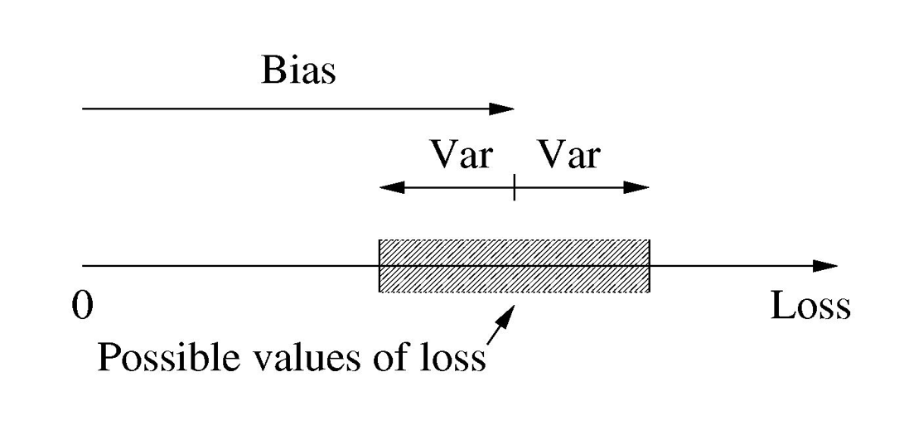

Another way to think about Bias & Variance

Slide 36
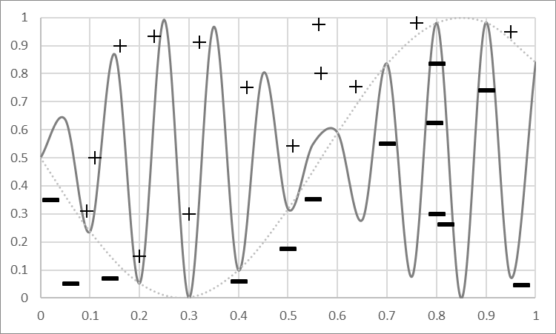
Bias and Variance: More Powerful Model
Model
Predicts +
Powerful Models can represent complex concepts
No Mistakes!
Model Predicts -

Slide 37
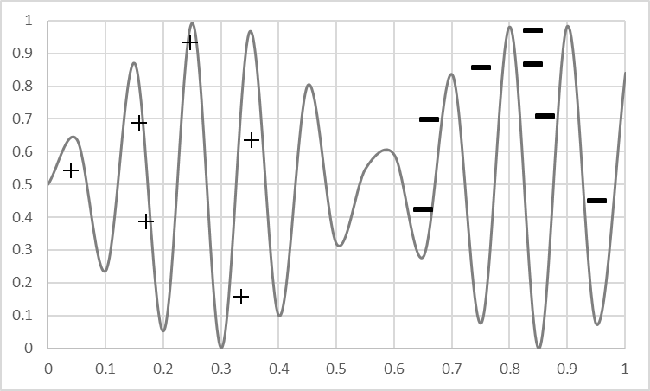
Bias and Variance: More Powerful Model
Model
Predicts +
But get more data…
Not good!
Model Predicts -

Slide 38
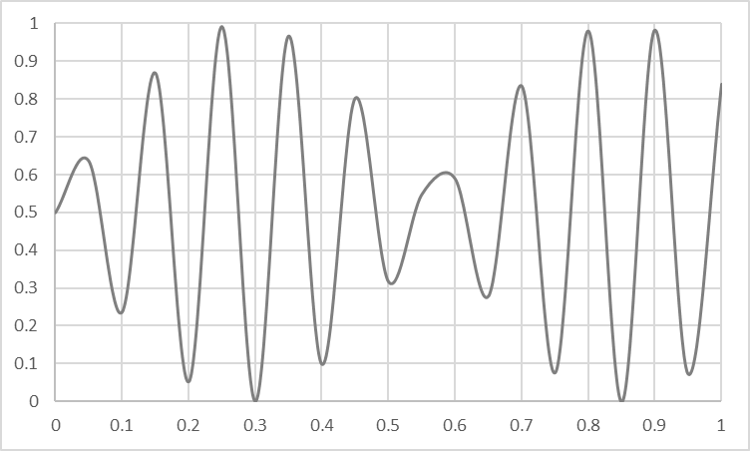
Overfitting vs Underfitting
Overfitting
Underfitting
Fitting the data too well
Features are noisy / uncorrelated to concept
Modeling process very sensitive (powerful)
Too much search
Learning too little of the true concept
Features don’t capture concept
Too much bias in model
Too little search to fit model

Slide 39
The Effect of Noise

Slide 40
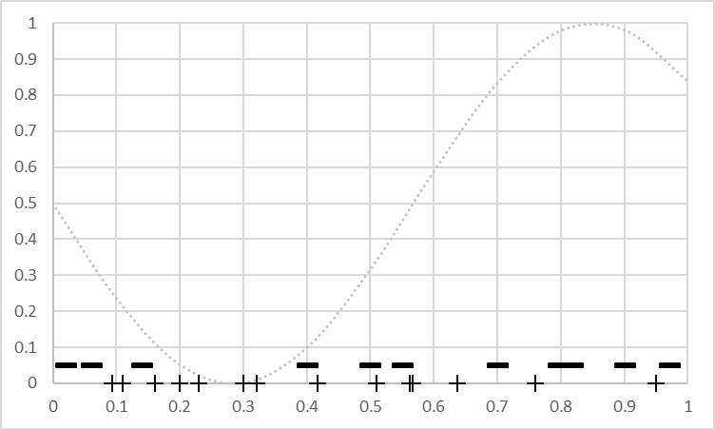
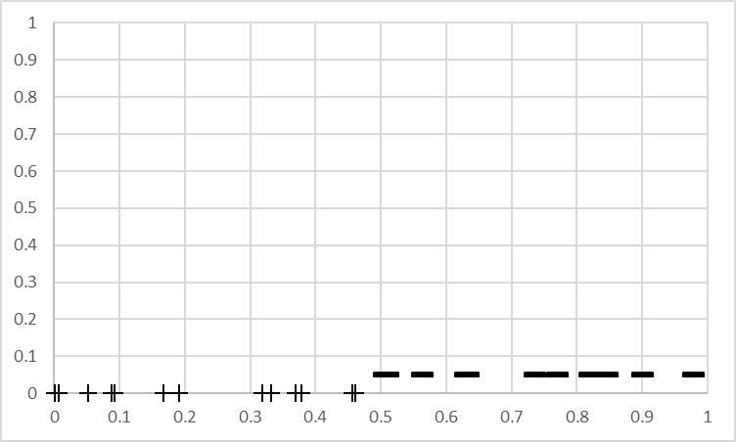
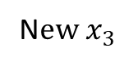
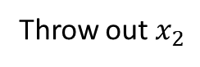
The Effect of Features
Not much info
Won’t learn well
Powerful -> high variance
Throw out $x_{2}$
Captures concept
Simple model -> low bias
Powerful -> low variance
N$ew x_{3}$

Slide 41
The Power of a Model Building Process
Weaker Modeling Process ( higher bias )
More Powerful Modeling Process (higher variance)
Simple Model (e.g. linear)
Fixed sized Model (e.g. fixed # weights)
Small Feature Set (e.g. top 10 tokens)
Constrained Search (e.g. few iterations of gradient descent)
Complex Model (e.g. high order polynomial)
Scalable Model (e.g. decision tree)
Large Feature Set (e.g. every token in data)
Unconstrained Search (e.g. exhaustive search)

Slide 42
Modeling to Balance Under & Overfitting
Data
Learning Algorithms
Feature Sets
Complexity of Concept
Search and Computation
Parameter sweeps!

Slide 43
Summary of Overfitting and Underfitting
Bias / Variance tradeoff a primary challenge in machine learning
Internalize: More powerful modeling is not always better
Learn to identify overfitting and underfitting
Tuning parameters & interpreting output correctly is key

Slide 44
I HOPE YOU LEARN A LOT & ENJOY THE TRAINING! THANK YOU ☺

